Slide 1
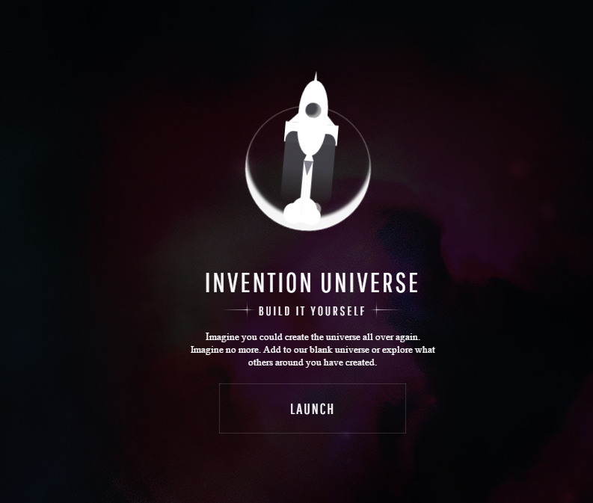

Slide 2
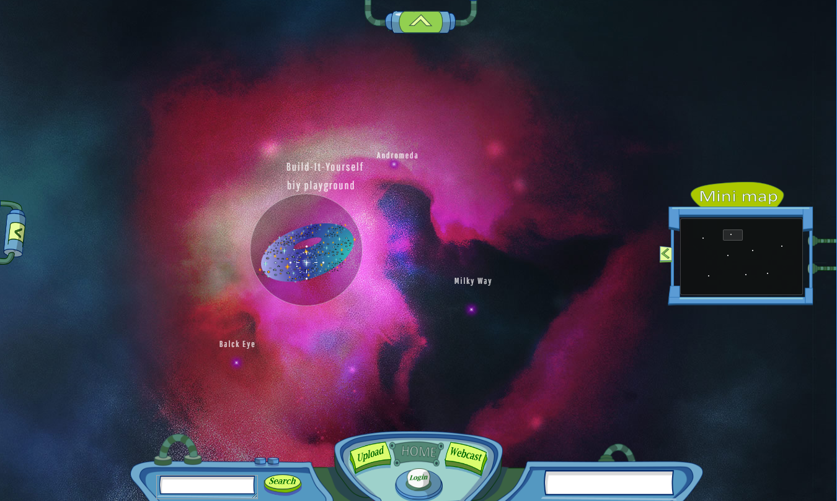

Slide 3
INVENTION UNIVERSE
We’re looking for a few intelligent life forms, smart ladies and hairy chested men to help us evolve a far out universe where art, nature and technology live in harmony. Many planets are barren and waiting for eager builders to bring them to life.
If you have the right stuff, we want you!”
Launch
How To Win Points | Design Goals | Wish List | Development Team | Trailers
Build-It-Yourself

Slide 5
Invention Universe
We’re looking for a few intelligent life forms, smart ladies and hairy chested men to help us evolve a utopian universe where art, nature and technology live in harmony. Many planets are barren and waiting for eager builders to bring them to life.
If you have the right stuff, we want you!”
Launch
How to win points
Trailers
Design goals
Wish list
Development Team

Slide 7
Galaxy

Slide 8

Galaxy

Slide 9
Galaxy

Slide 10
Galaxy

Slide 11
Star

Slide 12
Star
Build-It-Yourself

Slide 13
Planet

Slide 15
Planet

Slide 16
Planet
Worm holes or planets

Slide 17
Planet

Slide 18
Rocket
c
c
c

Slide 19
Rocket

Slide 20
Rocket

Slide 21
Alien

Slide 22
Alien

Slide 23
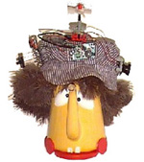

Alien

Slide 24


Star
Galaxy Goldfish

Slide 25

Galaxy Iron
Star Iron

Slide 26

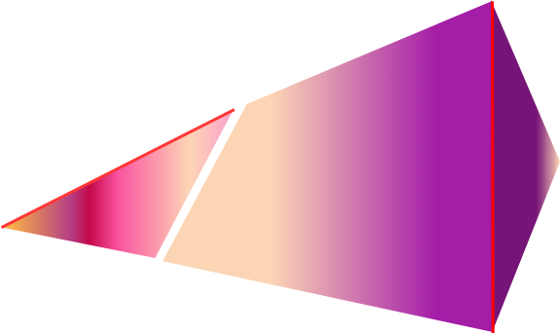
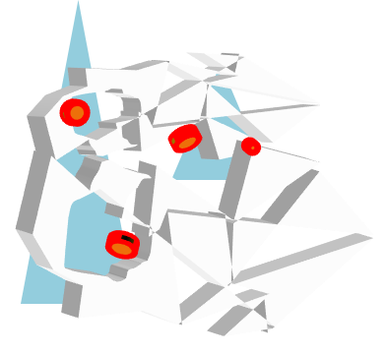
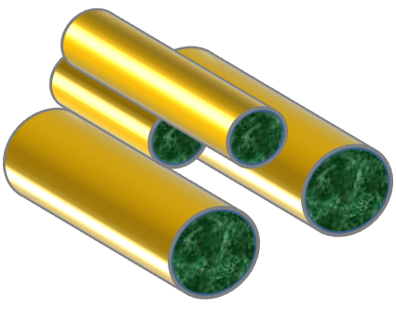

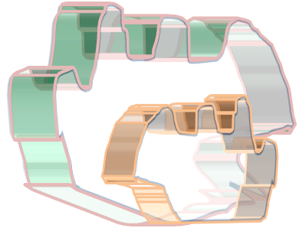
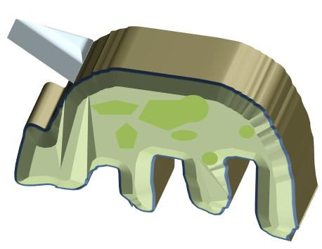
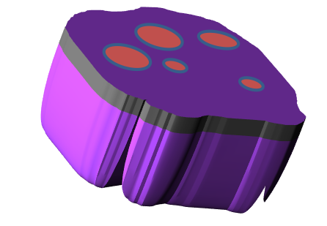
Planets

Slide 27
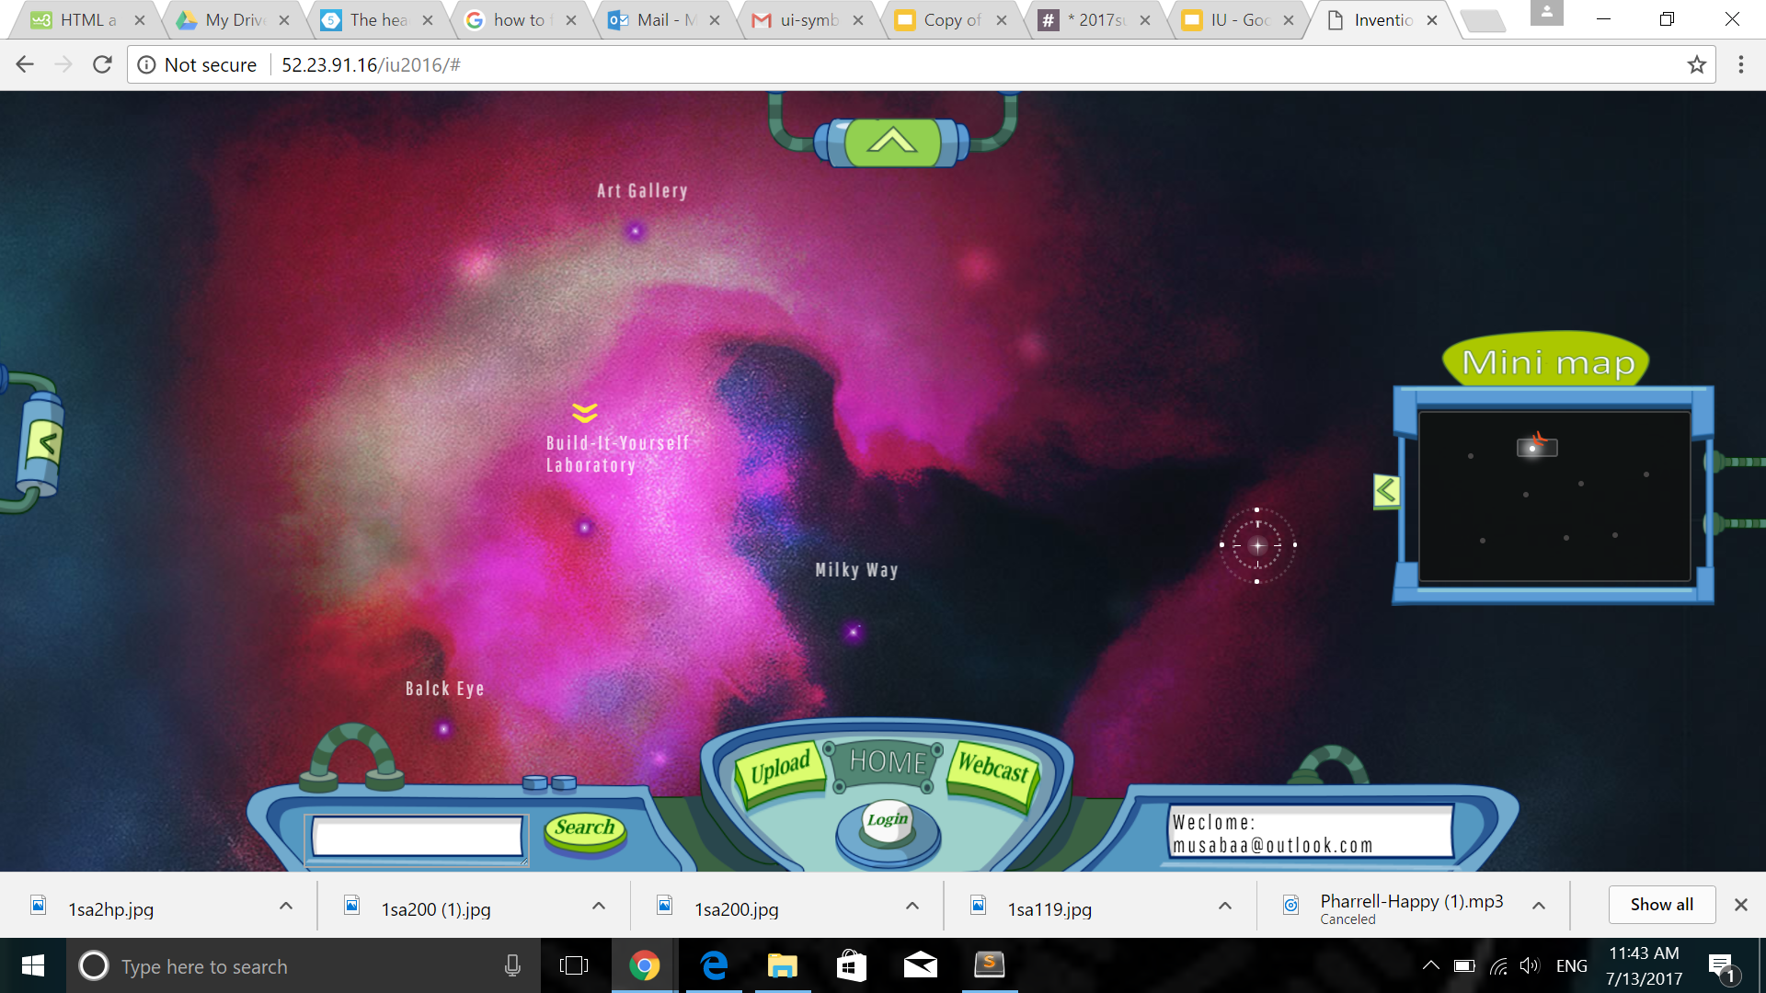
Coins:
3242
Next Achievement:
Space Ranger

Slide 28
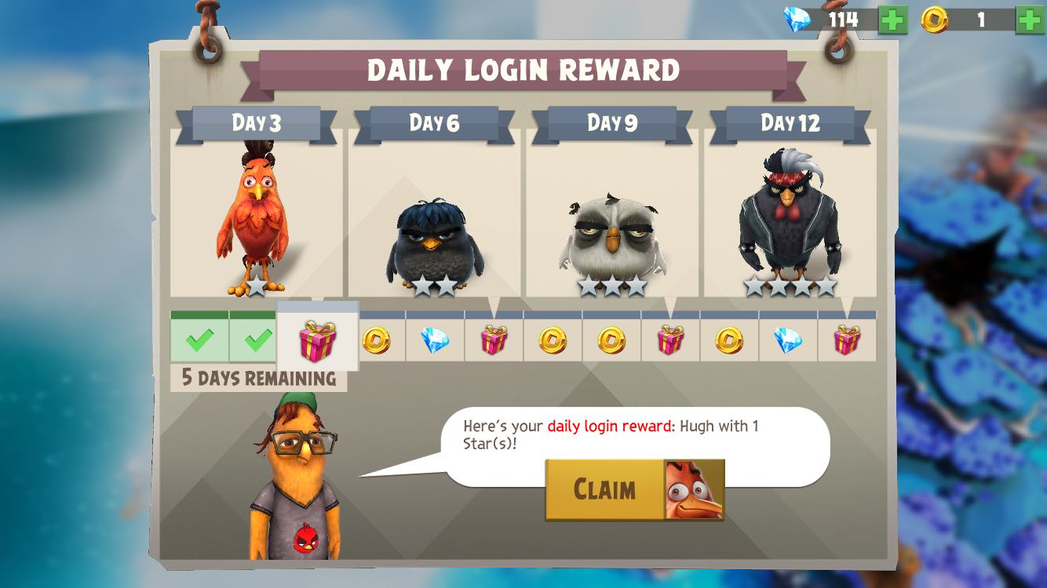
Earning Points on a daily streak basis

Slide 29
Pros and Cons of using the “daily streak” system
Pros
Cons
Encourages users to be more active (i.e. login everyday)
Good method of earning points and coins
Too similar to other “freemium games,” while Invention Universe serves a different purpose
Might stir away focus from the purpose of the app, which is to help builders connect

Slide 30
Money Payments
Many computer and iphone games and apps allow users to pay real money in order to get in-game currency

Slide 31
Pros and Cons
Pros
Cons
Revenue generates a profit + spent on more Invention Universe projects
Many users may not like that
Provides an unfair advantage

Slide 32
Other Ways to Earn Points/Coins
Upvoted posts and comments
In-game achievements (such as: “post 10 total projects” or “visit all the planets in your star system”
Mini-games and tasks

Slide 33
Coins can be used on:
Buying/Upgrading rockets
Decorating your planet
Buying new avatars

Slide 34
Chat Feature
A chat feature would be very useful, especially in keeping up with the goal of connecting and communicating with other users
Many interfaces can be used for this, but the main focus is to give users the ability to connect privately with other users, or to have them send general (group) messages.

Slide 35
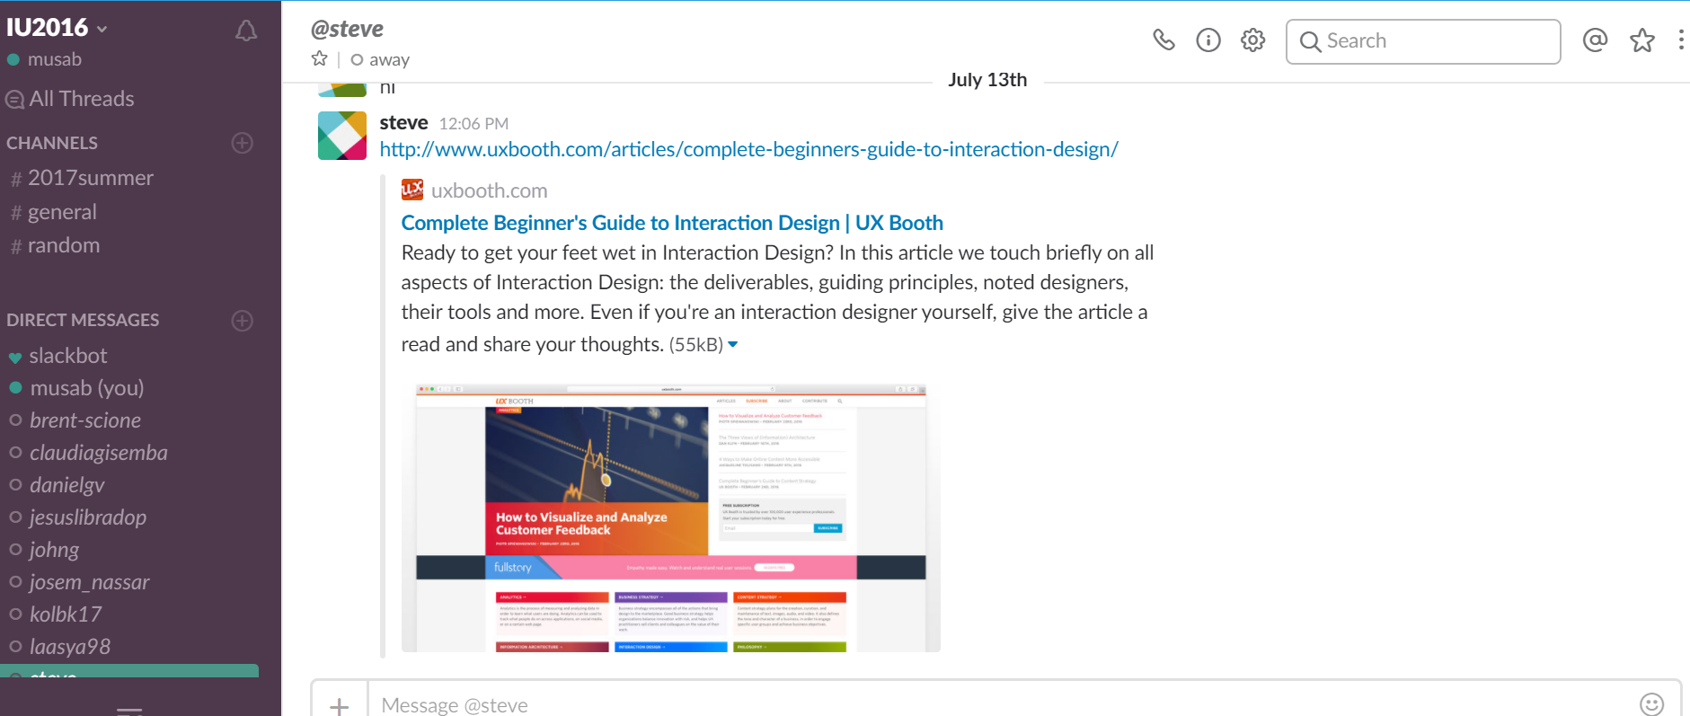
Chat Feature: Method A: channel system
Notes:
Also used in discord, a famous gaming communication app

Slide 36
Chat Feature: Method A: channel system
A chat tab would be accessible by all users, where they could use the channels for group discussions, or choose someone specifically to “Direct Message” him/her.
May be too complex for our audience

Slide 37
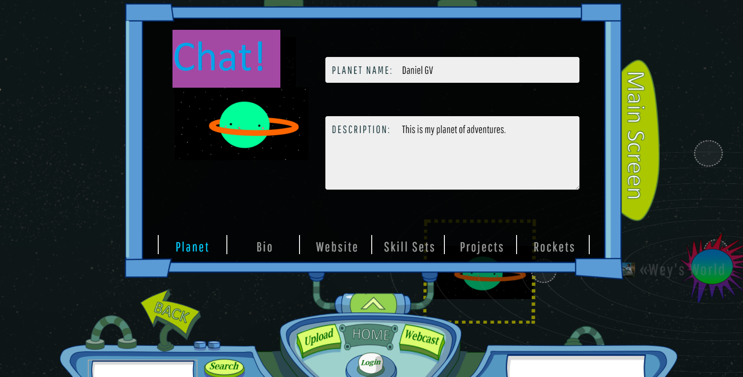
Chat Feature: Method B:

Slide 38
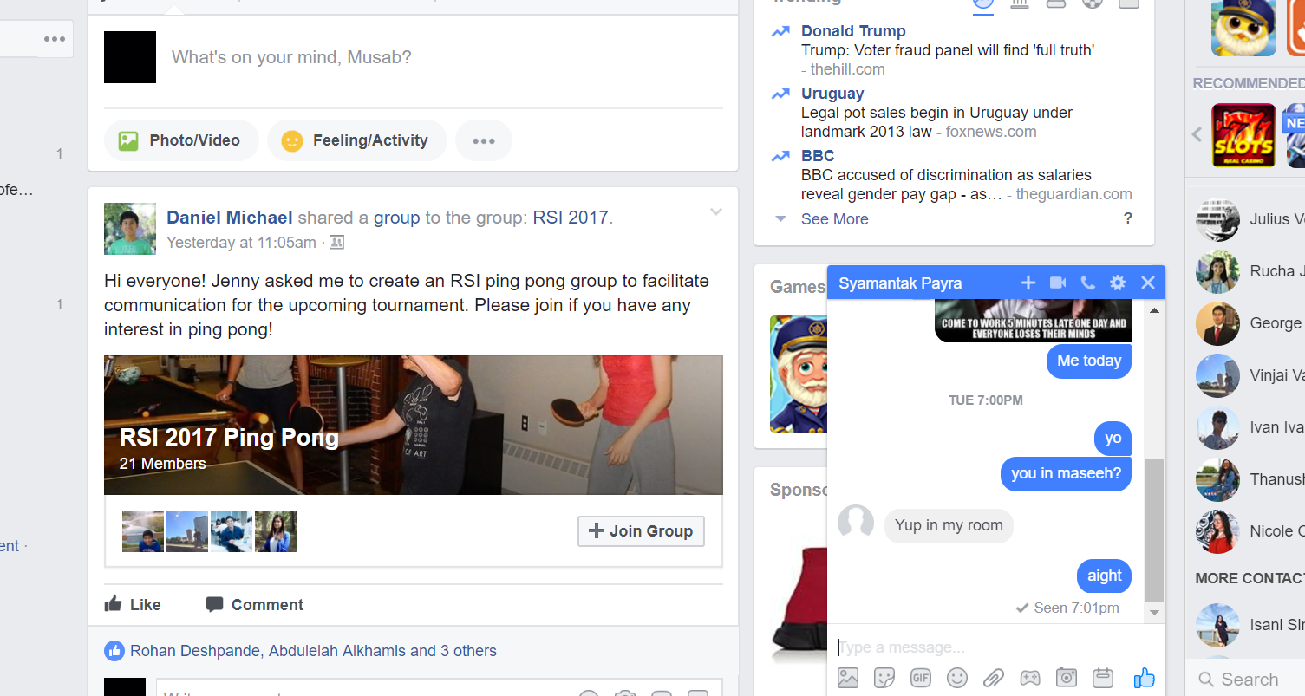
Chat Feature: Method B:

Slide 39
Chat Feature: Method B:

